Slide 1
Final project report CAD#5 region query
Group 8
B97502022 張浩軒 B00901024 張瑞宇
B00901079 陳威宇 B00901086 林宏驊

Slide 2
Outline
Introduction and Problem Definition
Core algorithm
Problem solving
Prospect
Reference

Slide 3
Outline
Introduction and Problem Definition
Core algorithm
Problem solving
Prospect
Reference

Slide 4
Introduction and Problem Definition
Find the number of polygons contained by a given (rectangular) window area.
Find the number of polygons interacting with a given window area.
Find the number of polygons interacting with given window that do not overlap with others interacting with the window.
Find the number of polygons whose areas are less than a given number.
Find the percentage of the given window area that is covered by polygons.

Slide 6
Problem 1: Find the number of polygons contained by a given (rectangular) window area.

Slide 7
Problem 2: Find the number of polygons interacting with a given window area.

Slide 8
Problem 3: Find the number of polygons interacting with given window that do not overlap with others interacting with the window.

Slide 9
Problem 4: Find the number of polygons whose areas are less than a given number.

Slide 10
Problem 4: Find the number of polygons whose areas are less than a given number.

Slide 11
Problem 5: Find the percentage of the given window area that is covered by polygons.

Slide 12
Outline
Introduction and Problem Definition
Core algorithm
Sweep line algorithm
Bentley–Ottmann algorithm
Find area
Problem solving
Prospect
Reference

Slide 13
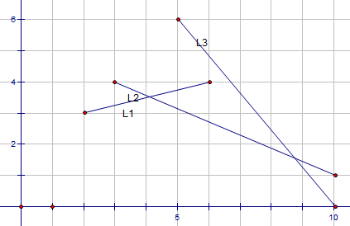

Sweep line algorithm
L1
L2
L1
L3
L3
L2
L1
L2
L3
L1
L2
L2

Slide 14
Bentley–Ottmann algorithm
binary search tree T of the line segments that cross the sweep line L
priority queue Q of potential future events
the potential future events consist of :
1. line segment begin/end points that have not yet been swept over
2. the points of intersection of pairs of lines containing pairs of segments that are immediately above or below each other.

Slide 15
L1 begin
L2 begin
L1 L2
cross
L3 begin
L1 end
L2 L3
cross
L2
end
L3
end
L1
L2
L1
L3
L3
L2
L1
L2
L3
L1
L2
L2

Slide 16
L1 begin
L2 begin
L3 begin
L1 end
L2
end
L3
end
L1

Slide 17
L2 begin
L1 L2
cross
L3 begin
L1 end
L2
end
L3
end
L2
L1

Slide 18
L3 begin
L1 end
L2
end
L3
end
L3
L1
L2

Slide 19
L1 end
L2 L3
cross
L2
end
L3
end
We can use Bentley–Ottmann algorithm
to find all the crossing points of lines
L3
L2

Slide 20
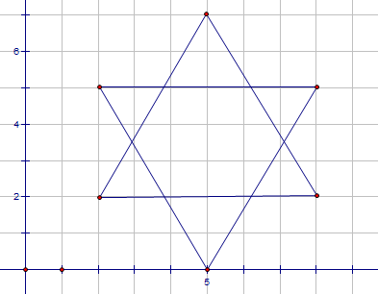
Sweep line algorithm—find area

Slide 21
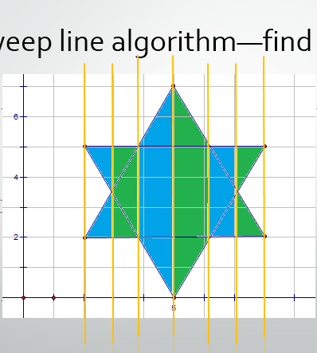
Sweep line algorithm—find area

Slide 22
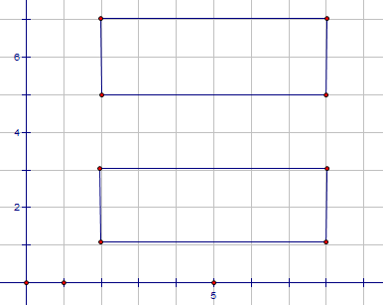
Sweep line algorithm—find area 2

Slide 23
Sweep line algorithm—find area 2

Slide 24
Sweep line algorithm—find area 2
Need to recognize upward sides and downward sides
Need to discard vertical lines

Slide 25
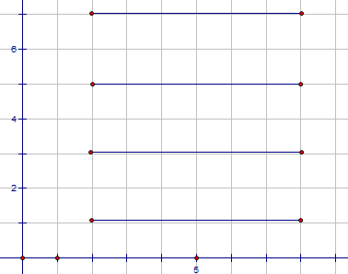
Sweep line algorithm—find area 2
up
down

Slide 26
Outline
Introduction and Problem Definition
Core algorithm
Problem solving
Main idea
Preset: File reading & problem 4
Utility: Problem 1 & problem 2
Core: Problem 3 & problem 5
details
Prospect
Reference

Slide 27
Problem solving :main idea
inputs
Construct data structure
Problem 4
preset
Analyze associated polygons
Problem 1
Problem 2
utility
Core problems
Problem 3
Problem 5
core

Slide 28
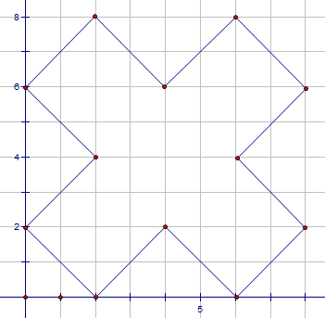
Preset : construct data structure
Poly 12
0 2 2 0 4 2 6 0 8 2 6 4 8 6 6 8 4 6 2 8 0 6 2 4
Class Polygon (all)
Area (problem 4)
Vertex list (problem 1 2)
Min enclosing rect.
Edge list (problem 3 5 )
Up and down

Slide 29

Preset for Problem 4 – Find the Area of an polygon

Slide 30
Problem 4 :Find the number of polygons whose areas are less than a given number
Binary Search
Complexity :O(P lg P + E )
(P: numbers of all polygons, E: Edges of all polygons)

Slide 31
Preset for Problem 1 &2 construct vertex list & min enclosing rect.
Poly 12
0 2 2 0 4 2 6 0 8 2 6 4 8 6 6 8 4 6 2 8 0 6 2 4

Slide 32
Problem 1: Find the number of polygons contained by a given (rectangular) window area.

Slide 33
Problem 1: Find the number of polygons contained by a given (rectangular) window area.
Linear search
Complexity :O(P)
(P: numbers of all polygons, E: Edges of associated polygons)

Slide 34
Problem 2: Find the number of polygons interacting with a given window area.

Slide 35
Problem 2: Find the number of polygons interacting with a given window area.
Interacting :
min enclosing rect must overlap

Slide 36
Problem 2: Find the number of polygons interacting with a given window area.
examine each sides:
Crossing = >interacting

Slide 37
Problem 2: Find the number of polygons interacting with a given window area.
Window contain min enclosing rect :
problem 1

Slide 38
Problem 2: Find the number of polygons interacting with a given window area.
Window is contained by min enclosing rect :
Need extra examination

Slide 39
Problem 2: Find the number of polygons interacting with a given window area.
When window is contained by min enclosing rect,
Window interacting polygon
if and only if the vertex of window is inside the polygon.

Slide 40
Problem 2: Find the number of polygons interacting with a given window area.
Complexity :O(P + E)
(P: numbers of all polygons, E: Edges of associated polygons)

Slide 41
Preset for Problem 3 &5 --Determine clockwise or counter clockwise
Poly 12
0 2 ,2 0, 4 2 ,6 0 ,8 2 ,6 4 ,8 6 ,6 8 ,4 6 ,2 8 ,0 6, 2 4

Slide 42
Preset for Problem 3 &5 --Judge upward and downward
Poly 12
0 2 ,2 0, 4 2 ,6 0 ,8 2 ,6 4 ,8 6 ,6 8 ,4 6 ,2 8 ,0 6, 2 4

Slide 43
Preset for Problem 3 &5 --Judge begin point and end point
Poly 12
0 2 ,2 0, 4 2 ,6 0 ,8 2 ,6 4 ,8 6 ,6 8 ,4 6 ,2 8 ,0 6, 2 4

Slide 44
Preset for Problem 3 &5 --construct edge list
Poly 12
0 2 ,2 0, 4 2 ,6 0 ,8 2 ,6 4 ,8 6 ,6 8 ,4 6 ,2 8 ,0 6, 2 4

Slide 45
Problem3:Find the number of polygons interacting with given window that do not overlap with others interacting with the window.

Slide 46
Problem3:Find the number of polygons interacting with given window that do not overlap with others interacting with the window.
Complexity :O( C lg E)
C = O (E^2)
(C: numbers of crossing points)

Slide 47
Problem 5 :Find the percentage of the given window area that is covered by polygons.

Slide 48
Problem 5 :Find the percentage of the given window area that is covered by polygons.
Complexity :O( C * H)
C = O (E^2) ,H = O (E)
(C: numbers of crossing points, E: Edges of associated polygons,
H: numbers of active edges)

Slide 49
Outline
Introduction and Problem Definition
Core algorithm
Problem solving
Main idea
Details
Changing sequences in RB tree
Prospect
Reference

Slide 50
Changing sequences in RB tree
L2>L1
L1>L2

Slide 51
Prospect
Precision – efficiency issue
discrete sweep line

Slide 52
Reference
演算法筆記 http://www.csie.ntnu.edu.tw/~u91029/
wikipedia http://en.wikipedia.org/

